Slide 1

DIGITAL SKILL FAIR 24.0 DIBIMBING.ID
DATA
SCIENCE
POKEMON DATA CLASSIFICATION ACCURACY BY UTILIZING MACHINE LEARNING

Slide 2


SALMA FIRDAUSI
SETIAWAN
A graduate of Applied and Computational Statistics, active in organizations and various committees. Proficient in data analysis, responsive in administrative tasks, and consistently strives to deliver optimal results. Happy to face new challenges and ready to make positive contributions through expertise and dedication in the work environment.
CONTINUE
Data science

Slide 3


TABLE OF CONTENTS
Dataset
Data Visulization
Data Preprocessing
Split Train Data and Test Data
Model Building
Conclusion

Slide 4

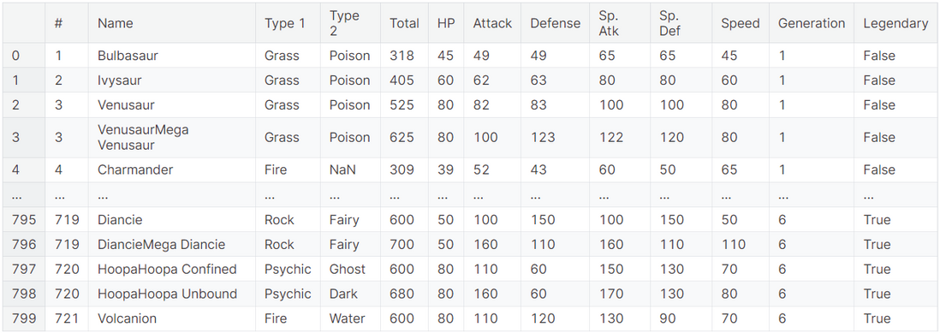
DATASET
This dataset contains information on all 800 Pokemon from all seven generations of Pokemon. The information contained in this dataset includes ID, name, type, hit point, etc.

Slide 5

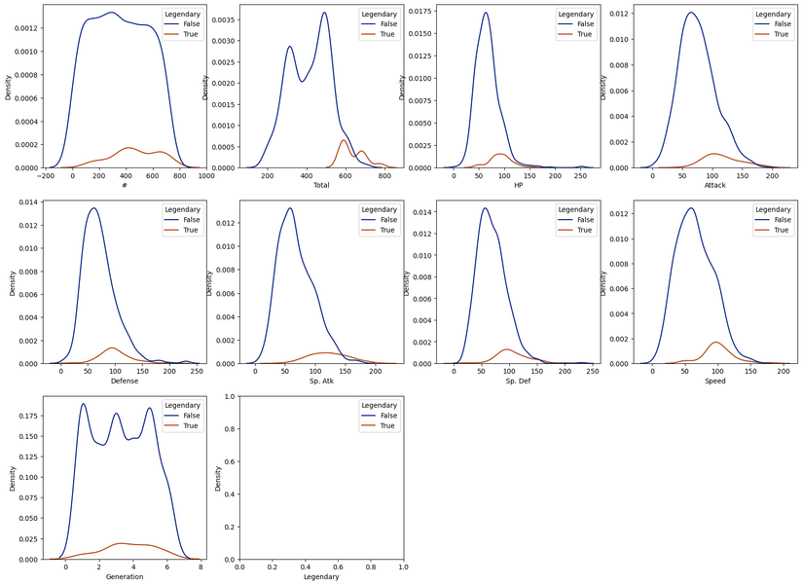
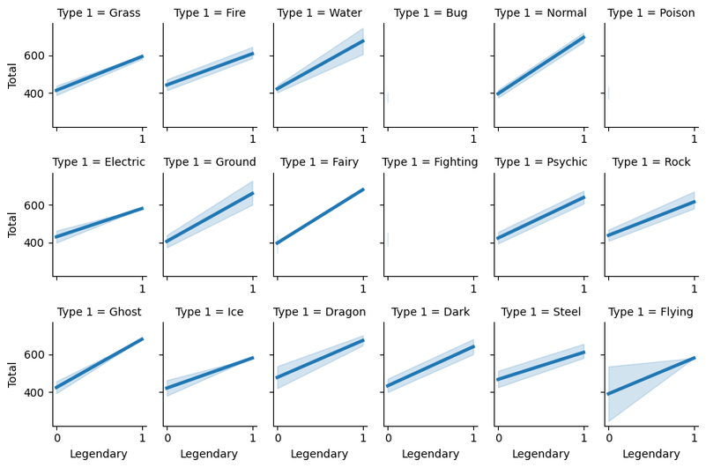
DATA VISULIZATION

Slide 6

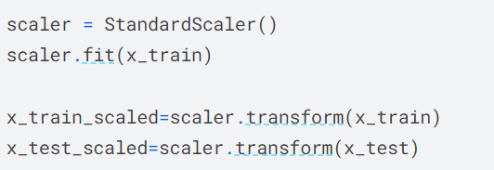
SPLIT TRAIN DATA AND TEST DATA

Slide 7

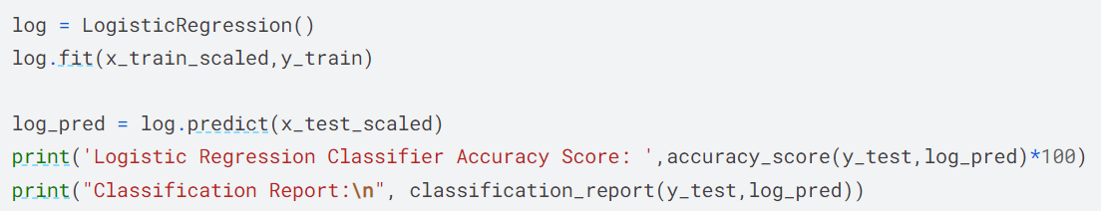
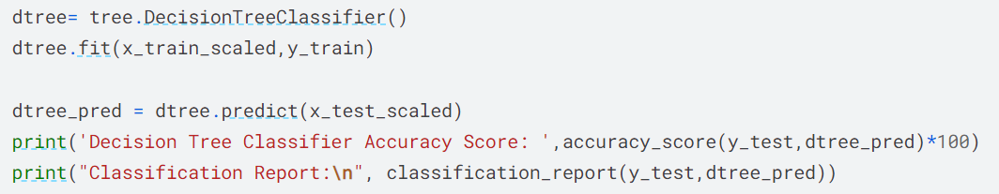
MODEL BUILDING
Logistic Regression
Decision Tree

Slide 8
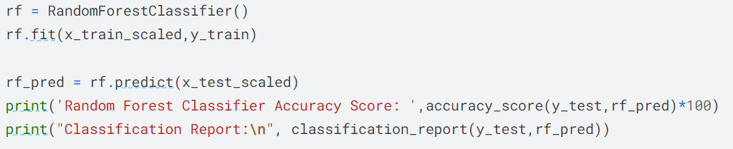
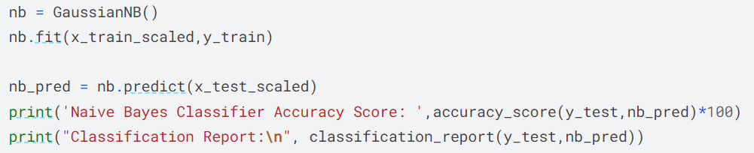
MODEL BUILDING
Random Forest
Naive Bayes

Slide 9
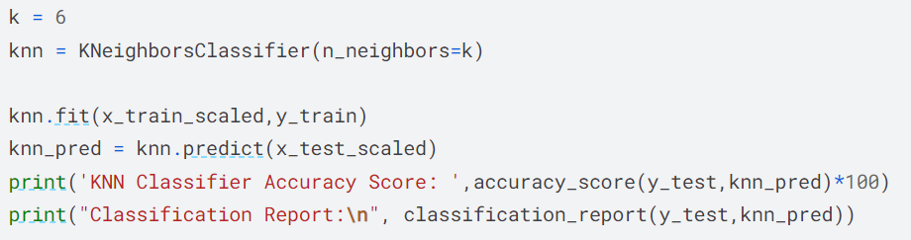
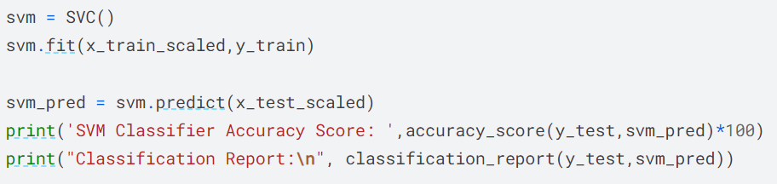
MODEL BUILDING
KNN
SVM

Slide 10
CONCLUSION
Using the logistic regression model has an accuracy rate of 96.25%, decision tree has an accuracy rate of 93.75%, random forest has an accuracy rate of 93.125%, naive bayes has an accuracy rate of 30%, KNN has an accuracy rate of 93.125%, and SVM has an accuracy rate of 92.5%. It can be concluded that using the logistic regression model has the highest accuracy rate of 96.25%.

Slide 11




THANK YOU
salmafirdausi07@gmail.com
https://medium.com/@salmafirdausi
https://github.com/salmafirdausi

